Slide 2
Identity
Teacher Identity
Lesson Identity
Md. Enamul Bari Polash
Asst. Teacher
Joyshing Govt. Primary School, Dhunat, Bogra.
Class: Four
Subject: English
Lesson: A Garment Worker’s Day
Lesson Unit: Reshma… accident.
Date: 17.02.16

Slide 3
Learning Outcomes
Student will able to know
Listening:
4.2.1 enjoy and understand simple stories.
Speaking:
3.1.1 ask and answer Wh questions.
Reading:
5.1.1 read silently with understanding paragraphs, stories and other texts.
Writing:
10.1.1 write a short paragraph by answering a set of questions.

Slide 4
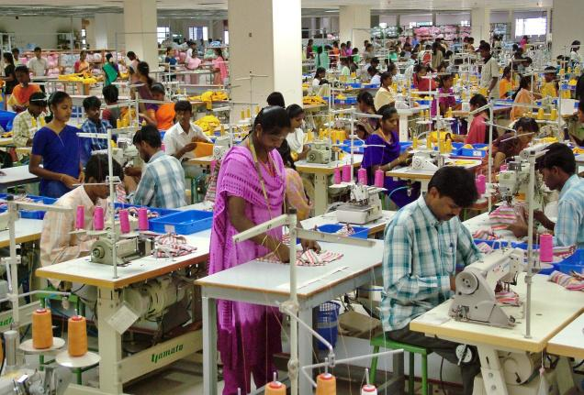
Please See This Picture

Slide 5
Today we are going to read
A Garment Worker’s Day

Slide 6
New Words
Garment
Erosion
Accident
Rickshaw

Slide 7
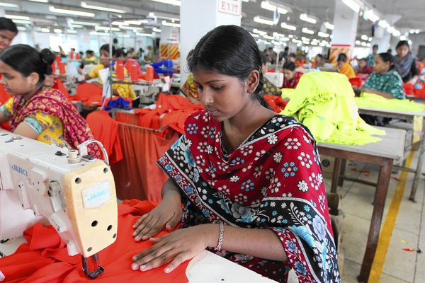
Reshma is a garment worker in Dhaka.

Slide 8
18
She is 18 years old.

Slide 9
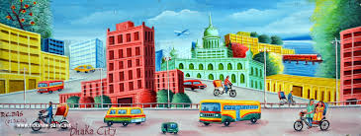
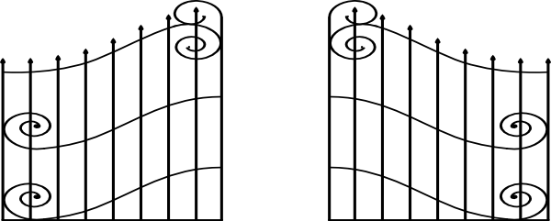
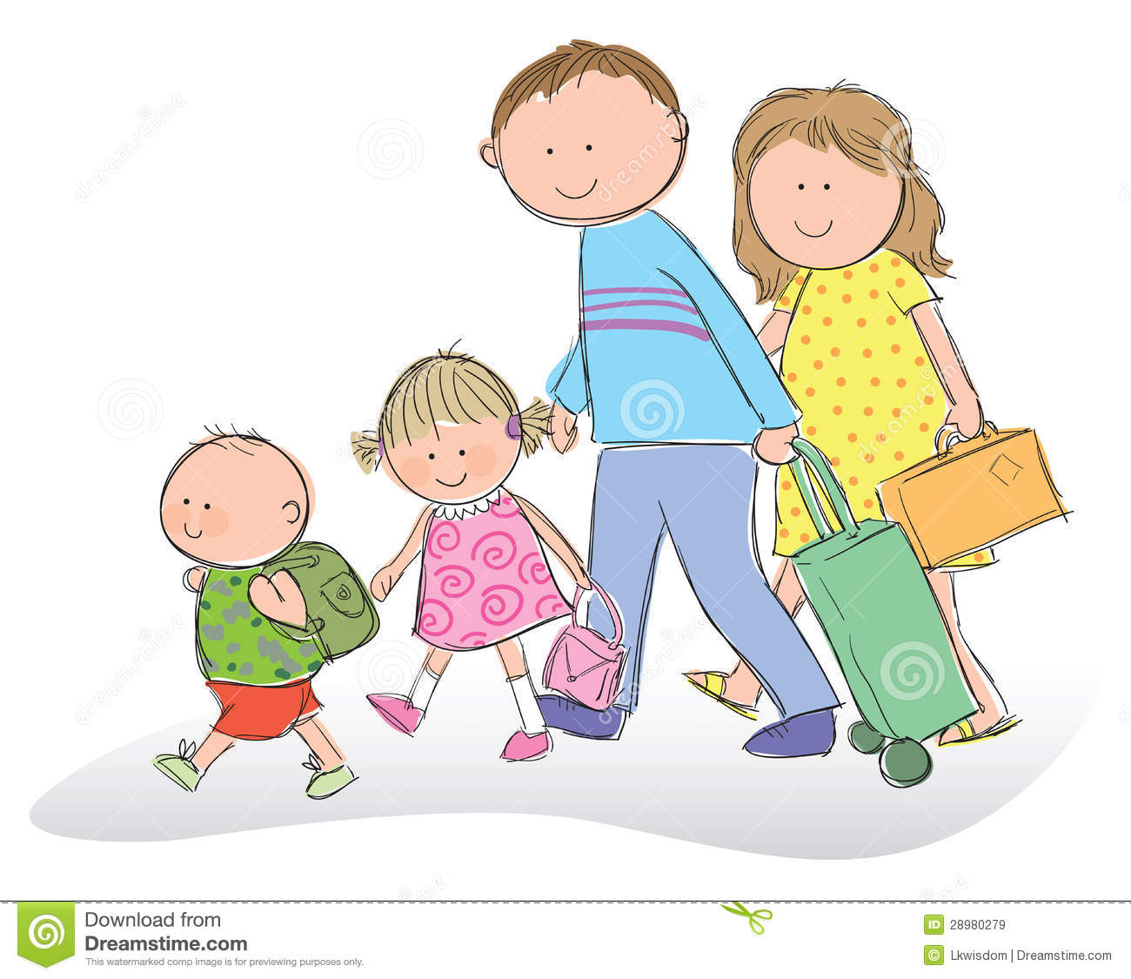
Her family came to Dhaka
from village eight years ago.
Dhaka

Slide 10
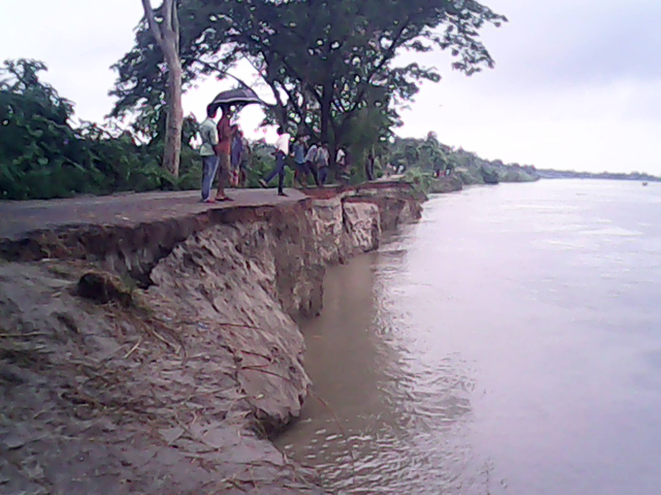
There was river erosion in her village.

Slide 11
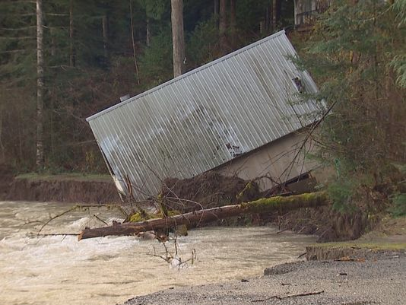
They lost their home.

Slide 12
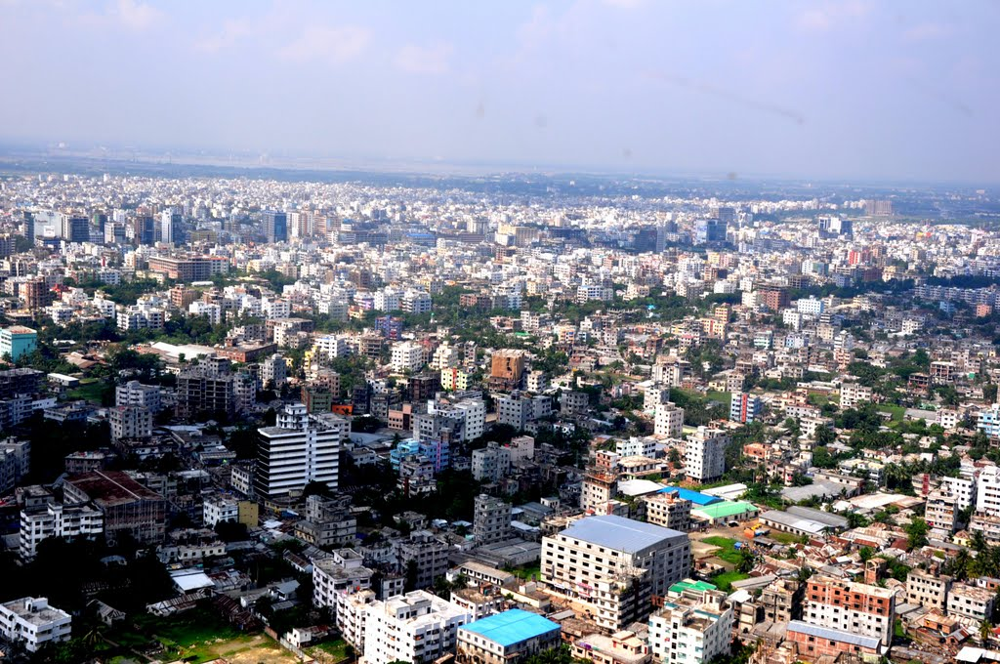
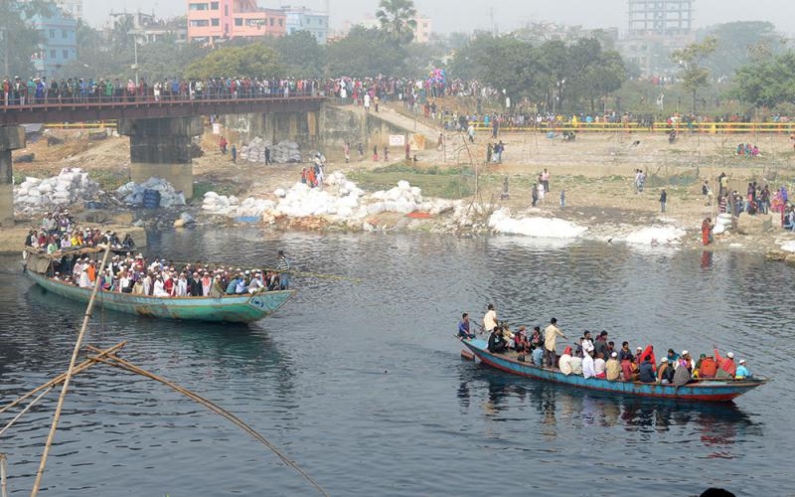
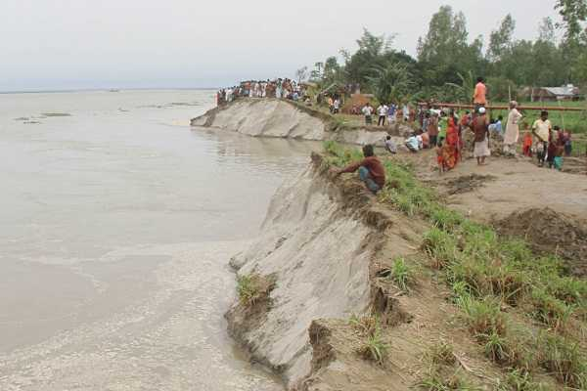
So they came to Dhaka.

Slide 13
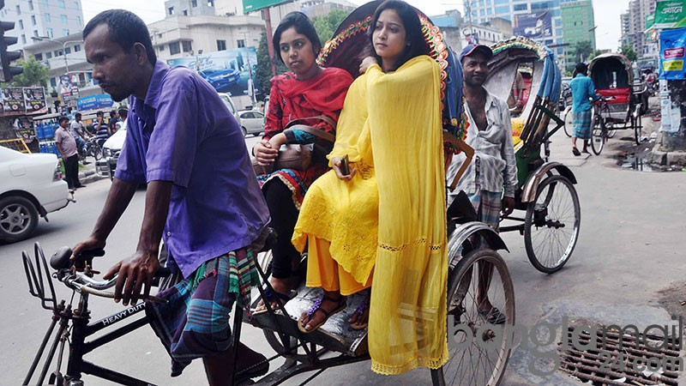
Reshma’s father worked as a
rickshaw driver,

Slide 14
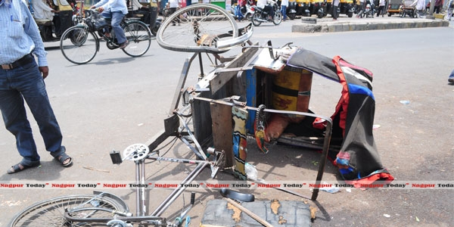
But he died in an accident.

Slide 15
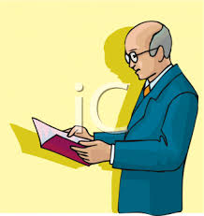
Teacher ‘s reading

Slide 16
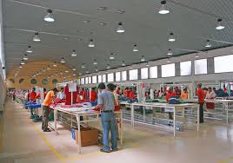
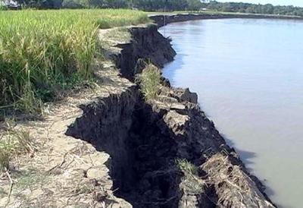
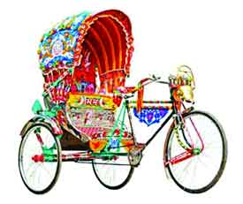
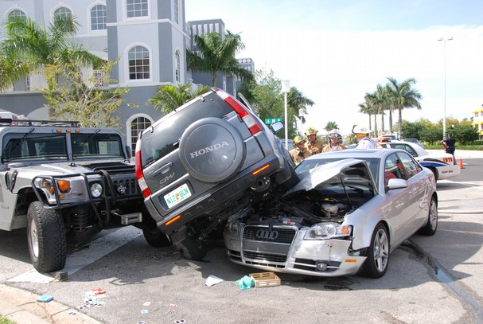
Garment
Where dress are marked.
Erosion
River removes soil.
Rickshaw
By which we can go one place to another.
Undesirable and unplanned incident.
Accident

Slide 17
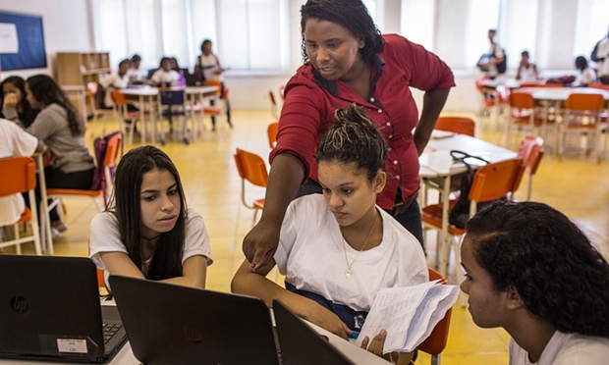
Now we are divided into Four groups ( Red, Blue, Green,Orange).
Now read the text

Slide 18
Now we read the
text in pair

Slide 19
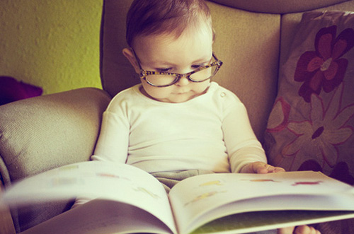
Now read individually.

Slide 20
What does Reshma do?
Reahma is a garment worker.
How old is she?
She is 18 years old.
What did her father do?
Her father was a rickshaw puller.

Slide 21
How many das ago did they come to Dhaka?
They came Dhaka eight years ago.
How did Reshma’s father die?
Reshma’s father died by accident.

Slide 22
Write the following questions...
What do you do?
How old are you?
What does your father do?

Slide 23
I am a student. I am nine years old. My father works in…………

